Slide 1
Neural Networks: Introduction
Ramesh S

Slide 2
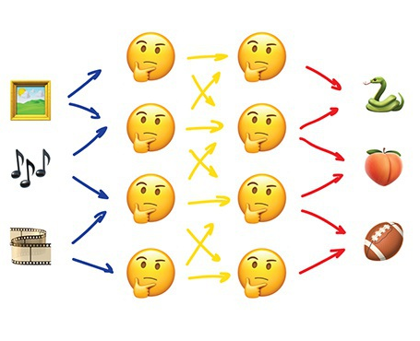
Neural Networks
“We have a thousand-layer network, dozens of video cards, but still no idea where to use it.”
“Let's generate cat pics!”

Slide 3
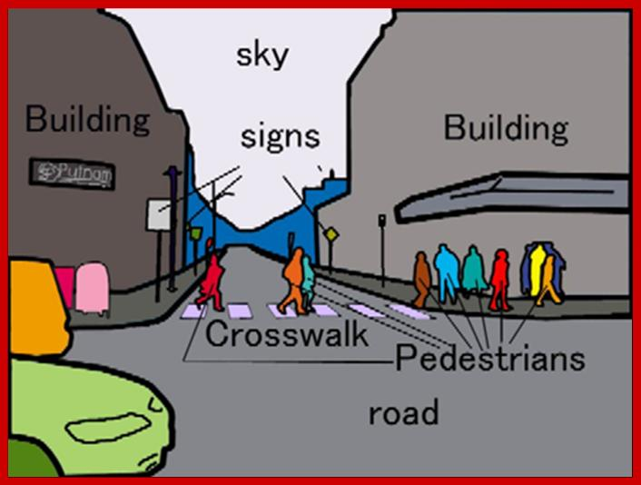
Neural Networks
Used today for:
Replacement of all algorithms previously discussed
Object identification on photos and videos
Speech recognition and synthesis
Image processing, style transfer
Machine translation

Slide 4
Neural Networks
Popular architectures:
Perceptron
Convolutional Network (CNN)
Recurrent Networks (RNN)
Autoencoders

Slide 5
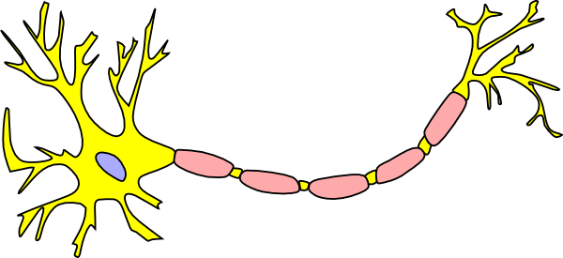
Neural Networks
Any neural network is basically a collection of neurons and connections between them.
Neuron is a function with a bunch of inputs and one output.
Its task is to take all numbers from its input, perform a function on them and send the result to the output.
Output
Input

Slide 6
Neural Networks
Here is an example of a simple but useful in real life neuron: sum up all numbers from the inputs
If that sum is bigger than N — give 1 as a result.
Otherwise — zero.

Slide 7
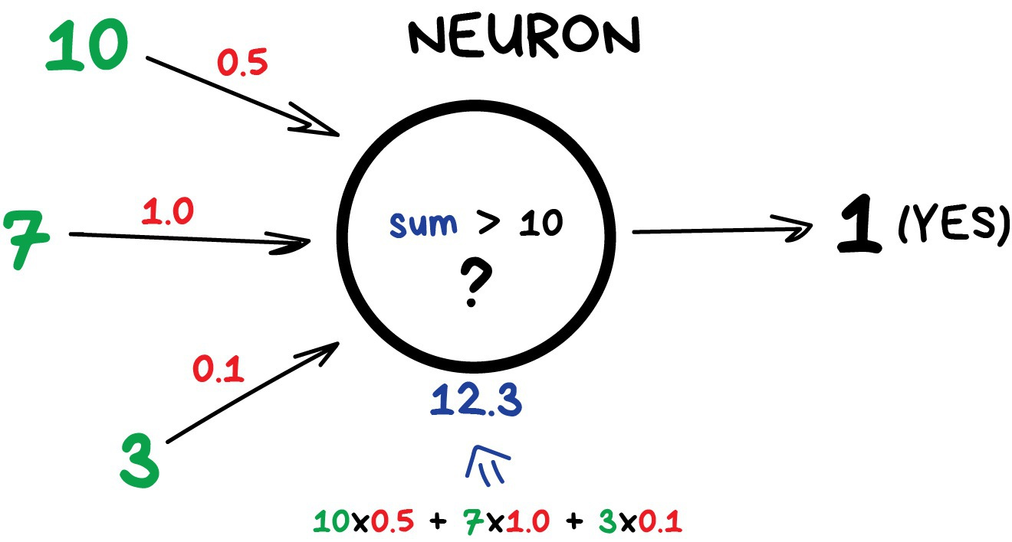

Slide 8
Neural Networks: Connections
Connections are like channels between neurons.
They connect outputs of one neuron with the inputs of another so they can send digits to each other.
Each connection has only one parameter — weight.

Slide 9
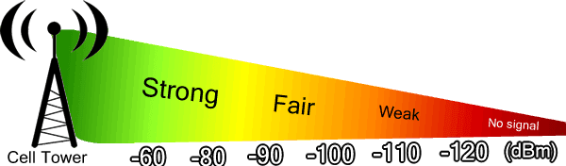
Neural Networks: Connections
It's like a connection strength for a signal.
When the number 10 passes through a connection with a weight 0.5 it turns into 5.
These weights tell the neuron to respond more to one input and less to another.
Weights are adjusted when training — that's how the network learns.

Slide 10


Neural Networks
To prevent the network from falling into anarchy, the neurons are linked by layers, not randomly.
Within a layer neurons are not connected, but they are connected to neurons of the next and previous layers.
Data in the network goes strictly in one direction — from the inputs of the first layer to the outputs of the last.

Slide 11
Neural Networks
If you throw in a sufficient number of layers and put the weights correctly, you will get the following:
by applying to the input, say, the image of handwritten digit 4, black pixels activate the associated neurons,
they activate the next layers, and so on and on,
until it finally lights up the exit in charge of the four.
The result is achieved.

Slide 12
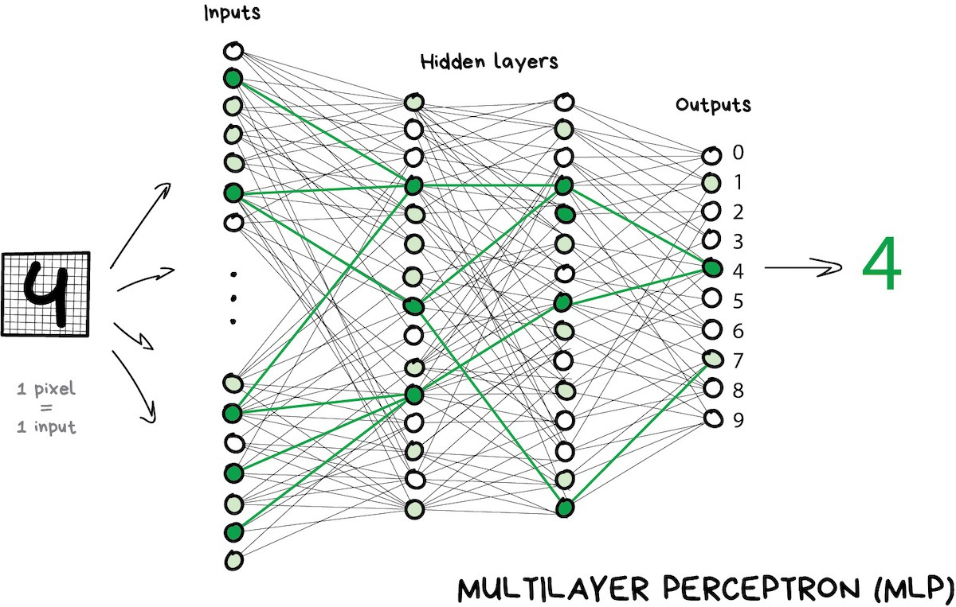

Slide 13
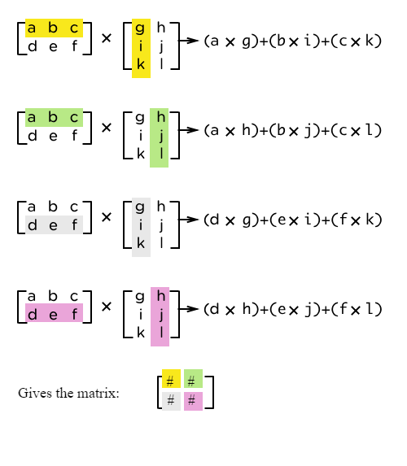
Neural Networks
When doing real-life programming nobody is writing neurons and connections.
Instead, everything is represented as matrices and calculated based on matrix multiplication for better performance.

Slide 14
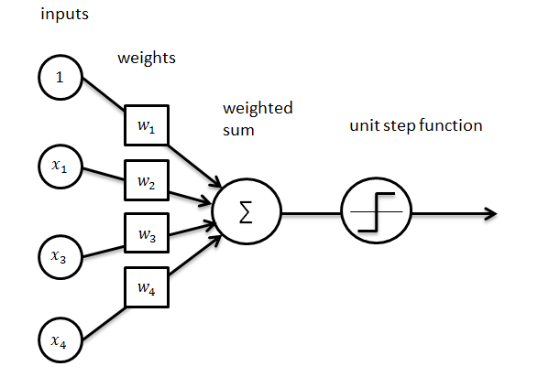
Neural Networks
A network that has multiple layers that have connections between every neuron is called a perceptron (MLP) and considered the simplest architecture for a novice. (Not for production)

Slide 15
Neural Networks
After we constructed a network, our task is to assign proper ways so neurons will react correctly to incoming signals.
Now is the time to remember that we have data that is samples of 'inputs' and proper 'outputs'.
We will be showing our network a drawing of the same digit 4 and tell it 'adapt your weights so whenever you see this input your output would emit 4'.

Slide 16
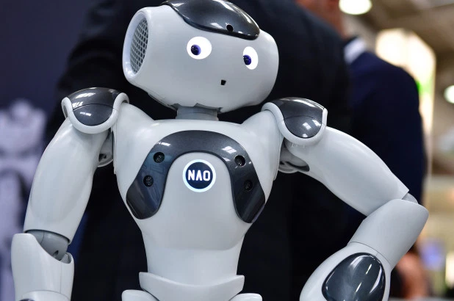
Neural Networks
To start with, all weights are assigned randomly.
After we show it a digit, it emits a random answer because the weights are not correct yet, and we compare how much this result differs from the right one.
Then we start traversing network backward from outputs to inputs and tell every neuron 'hey, you did activate here but you did a terrible job and everything went downhill from here, let's keep less attention to this connection and more of that one, okay?'.

Slide 17
Neural Networks
After hundreds of thousands of such cycles of 'infer-check-punish', there is a hope that the weights are corrected and act as intended.
The science name for this approach is Backpropagation, or a 'method of backpropagating an error'.
Funny thing it took twenty years to come up with this method. Before this we still taught neural networks somehow.

Slide 18
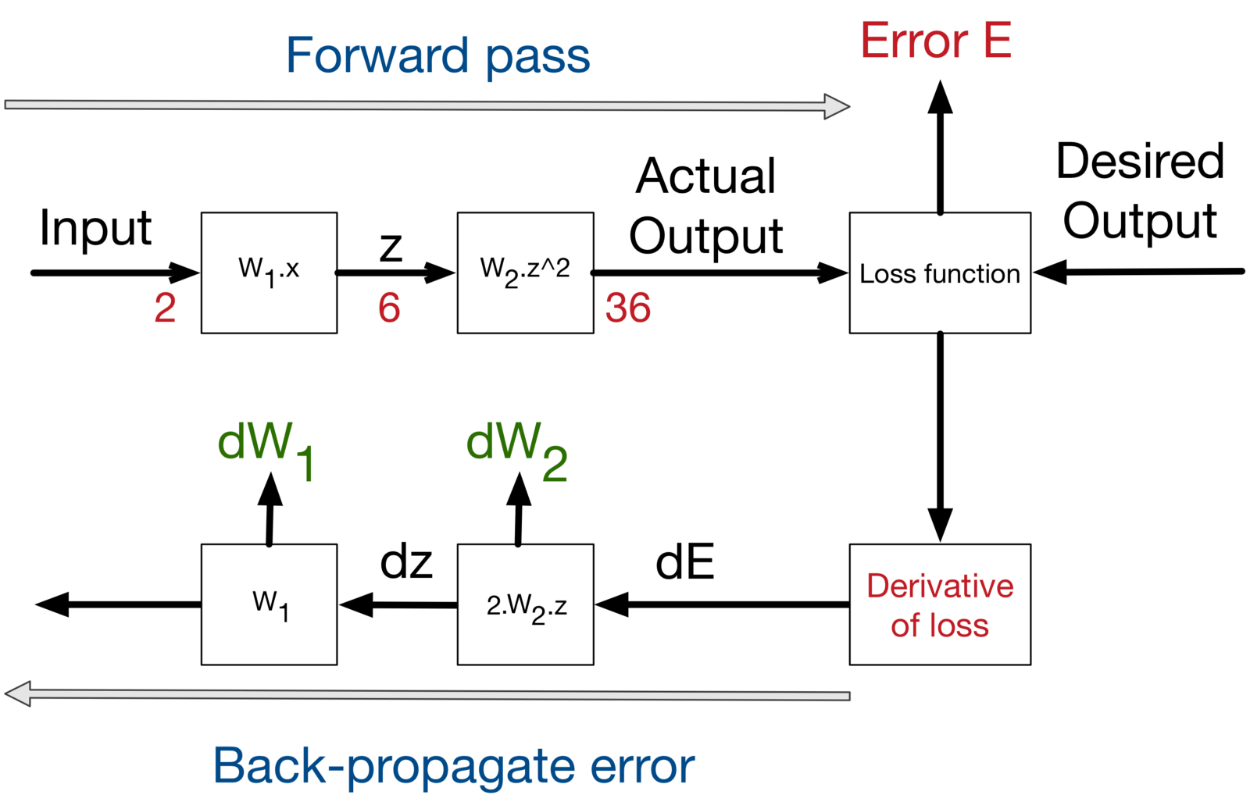

Slide 19
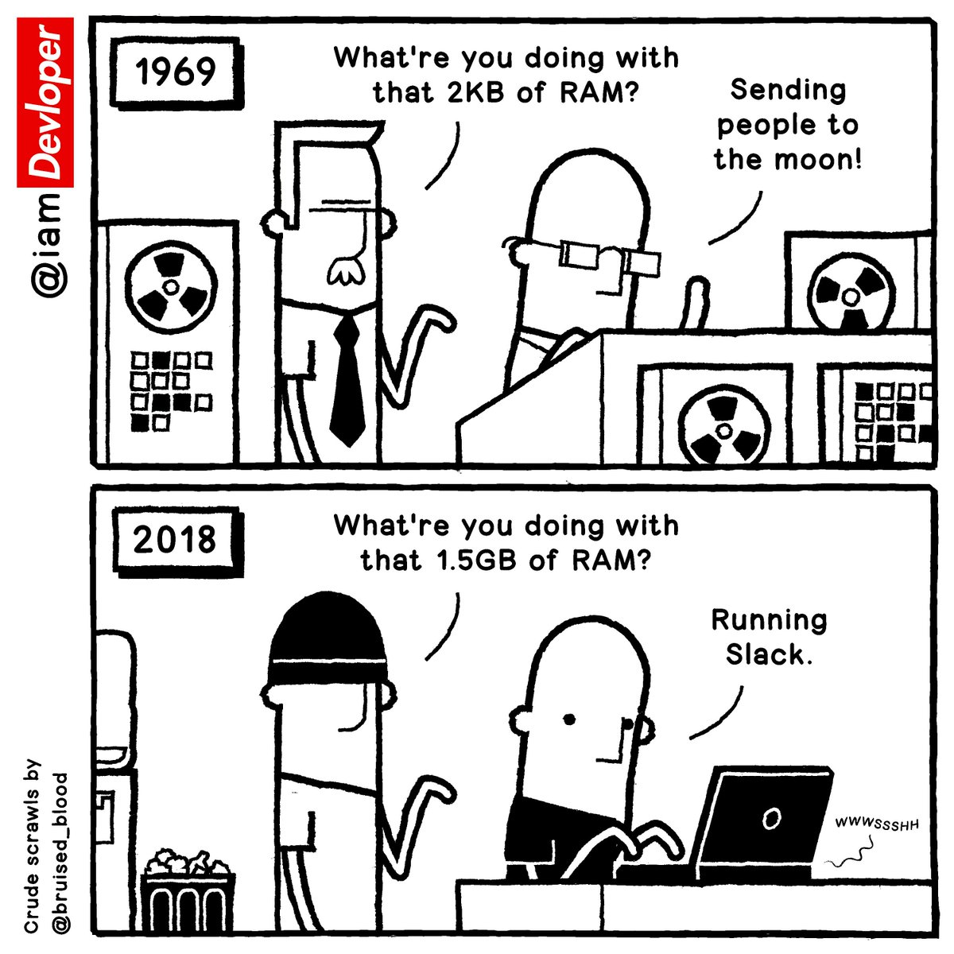
Neural Networks
It turned out networks with a large number of layers required computation power unimaginable at that time.
Nowadays any gamer PC with geforces outperforms the datacenters of that time.
So people didn't have any hope then to acquire computation power like that and neural networks were a huge bummer.
And then ten years ago deep learning rose.

Slide 20
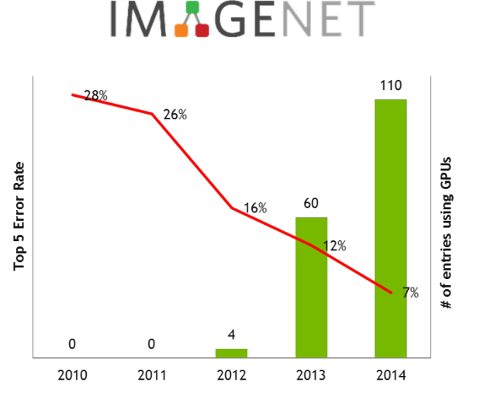
Neural Netwoks - Deep Learning
In 2012 convolutional neural networks acquired an overwhelming victory in ImageNet competition that made the world suddenly remember about methods of deep learning described in the ancient 90s.
Now we have video cards!

Slide 21
Neural Netwoks - Deep Learning
Differences of deep learning from classical neural networks were in new methods of training that could handle bigger networks.
Nowadays only theoretics would try to divide which learning to consider deep and not so deep.
And we, as practitioners are using popular 'deep' libraries like Keras, TensorFlow & PyTorch even when we build a mini-network with five layers.
Just because it's better suited than all the tools that came before.
And we just call them neural networks.

Slide 22
Neural Netwoks - Types
Two main kinds nowadays:
Convolutional Neural Networks (CNN)
Recurrent Neural Networks (RNN)

Slide 23
Convolutional Neural Networks

Slide 24

Convolutional Neural Networks
Convolutional neural networks are all the rage right now.
They are used to search for objects on photos and in videos, face recognition, style transfer, generating and enhancing images, creating effects like slow-mo and improving image quality.
Nowadays CNNs are used in all the cases that involve pictures and videos.
Even in your iPhone several of these networks are going through your photos to detect objects in those.

Slide 25
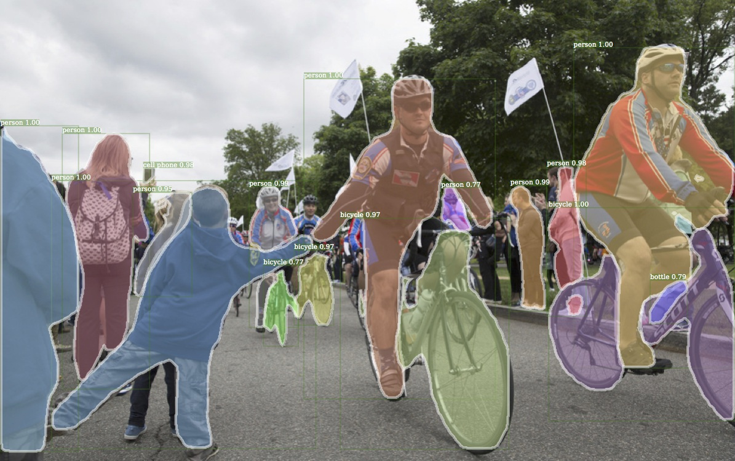
Image above is a result produced by Detectron that was recently open-sourced by Facebook

Slide 26

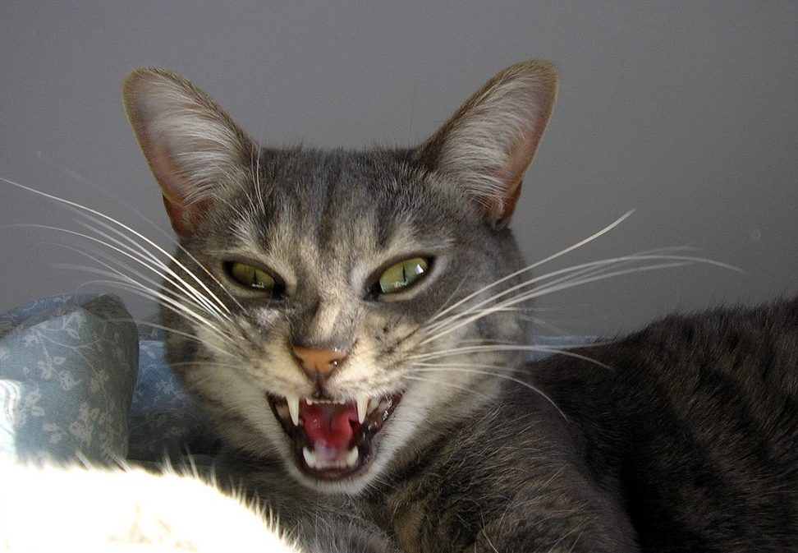
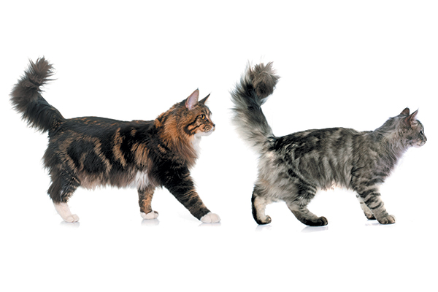
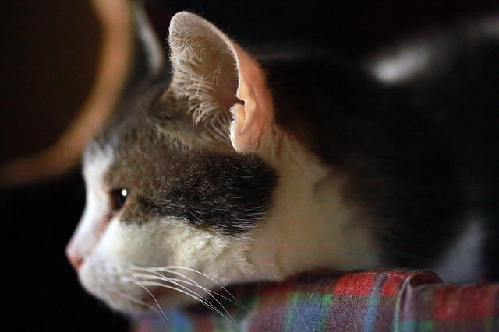
Convolutional Neural Networks
A problem with images was always the difficulty of extracting features out of them.
You can split text by sentences, lookup words' attributes in specialized vocabularies, etc.
But images had to be labeled manually to teach the machine where cat ears or tails were in this specific image.
This approach got the name 'handcrafting features' and used to be used almost by everyone.

Slide 27
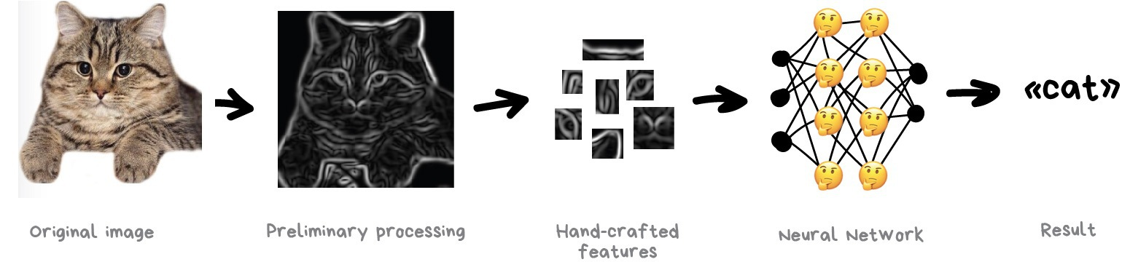

Slide 28
Convolutional Neural Networks
There are lots of issues with the handcrafting.
First of all, if a cat had its ears down or turned away from the camera: you are in trouble, the neural network won't see a thing.
Secondly, try naming on the spot 10 different features that distinguish cats from other animals.
When I see a black blob rushing past me at night — even if I only see it in the corner of my eye — I would definitely tell a cat from a rat.
Because people don't look only at ear form or leg count and account lots of different features they don't even think about. And thus cannot explain it to the machine.

Slide 29
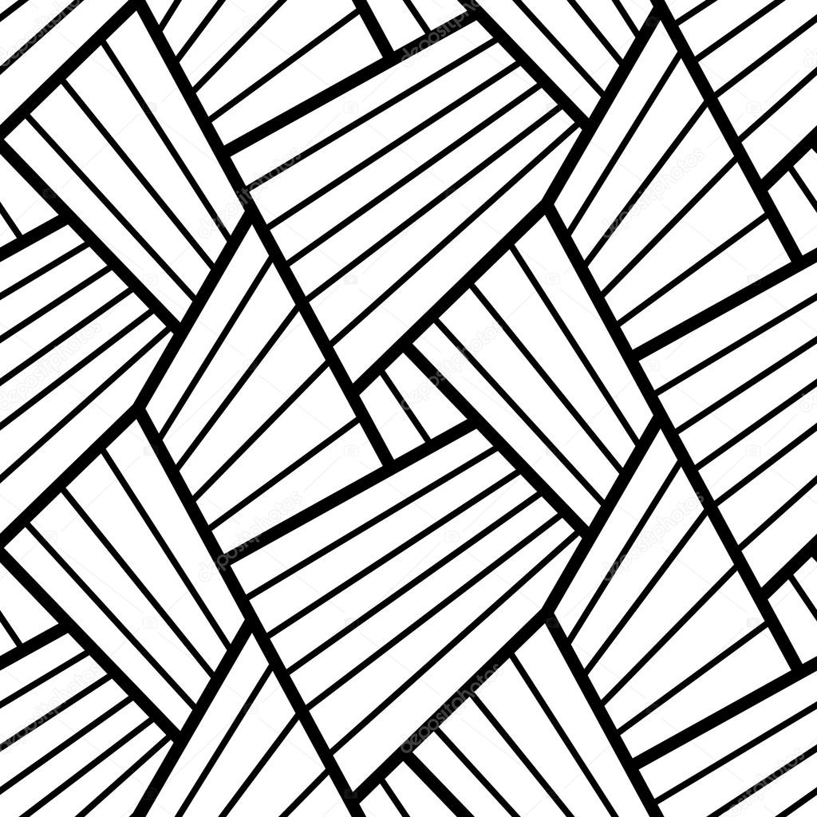

Convolutional Neural Networks
So it means the machine needs to learn such features on its own, building on top of basic lines.
We'll do the following: first, we divide the whole image into 8x8 pixel blocks and assign to each a type of dominant line – either horizontal [-], vertical [|] or one of the diagonals [/].
It can also be that several would be highly visible — this happens and we are not always absolutely confident.

Slide 30

Convolutional Neural Networks
Output would be several tables of sticks that are in fact the simplest features representing objects edges on the image.
They are images on their own but built out of sticks.
So we can once again take a block of 8x8 and see how they match together.
And again and again…

Slide 31
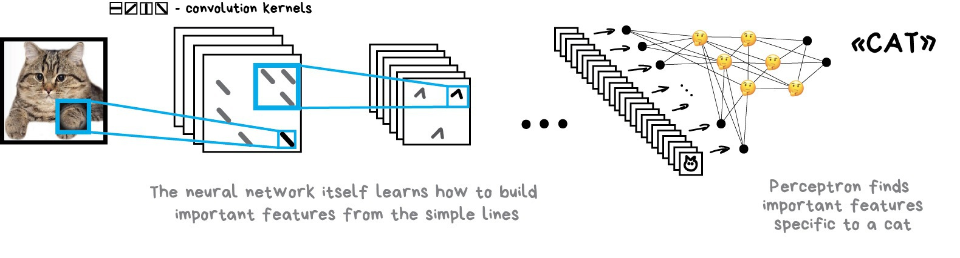
Convolutional Neural Networks
This operation is called convolution, which gave the name for the method.
Convolution can be represented as a layer of a neural network, because each neuron can act as any function.

Slide 32
Give your neural net a fish and it will be able to detect fish for the rest of its life. Give your neural net a fishing rod and it will be able to detect fishing rods for the rest of its life..

Slide 33
Recurrent Neural Networks (RNN)

Slide 34
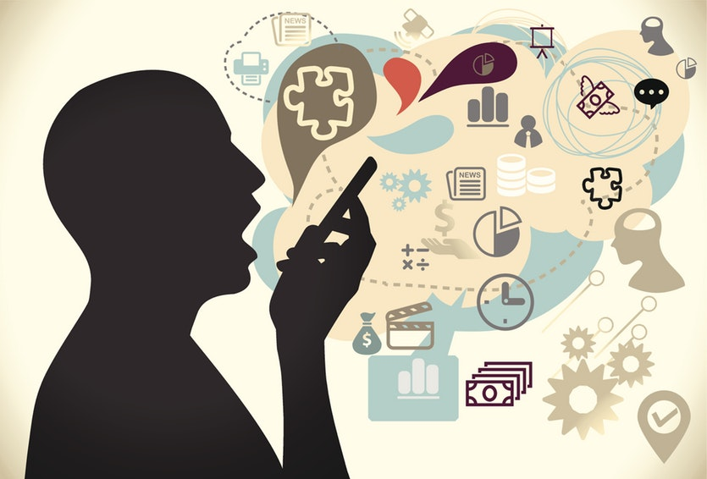
Recurrent Neural Networks (RNN)
The second most popular architecture today.
Recurrent networks gave us useful things like neural machine translation, speech recognition and voice synthesis in smart assistants.
RNNs are the best for sequential data like voice, text or music.

Slide 35
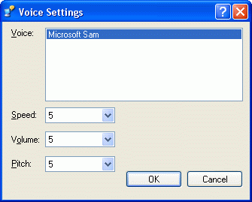
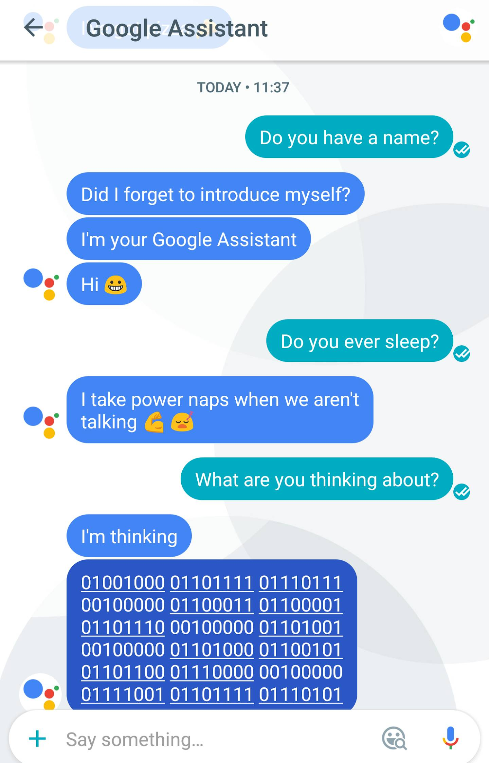
Recurrent Neural Networks (RNN)
Remember Microsoft Sam, the old-school speech synthesizer from Windows XP?
That funny guy builds words l e t t e r b y l e t t e r, trying to glue them up together.
Now, look at Amazon Alexa or Assistant from Google.
They don't only say the words clearly, they even place the right accents!

Slide 36
Recurrent Neural Networks (RNN)
All because modern voice assistants are trained to speak not letter by letter, but on whole phrases at once.
We can take a bunch of voiced texts and train a neural network to generate an audio-sequence closest to the original speech.
Don’t just believe it! Witness!!

Slide 37
Recurrent Neural Networks (RNN)
In other words, we use text as input and its audio as the desired output.
We ask a neural network to generate some audio for the given text, then compare it with the original, correct errors and try to get as close as possible to ideal.
Sounds like a classical learning process.
Even a perceptron is suitable for this. But how should we define its outputs?
Firing one particular output for each possible phrase is not an option — obviously.

Slide 38

Recurrent Neural Networks (RNN)
Here we'll be helped by the fact that text, speech or music are sequences.
They consist of consecutive units like syllables.
They all sound unique but depend on previous ones.
Lose this connection and you get dubstep.

Slide 39
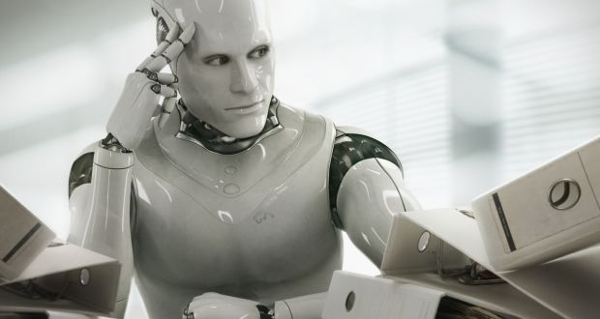
Recurrent Neural Networks (RNN)
We can train the perceptron to generate these unique sounds, but how will it remember previous answers?
So the idea is to add memory to each neuron and use it as an additional input on the next run.
A neuron could make a note for itself - hey, we had a vowel here, the next sound should sound higher (it's a very simplified example).
That's how recurrent networks appeared.

Slide 40
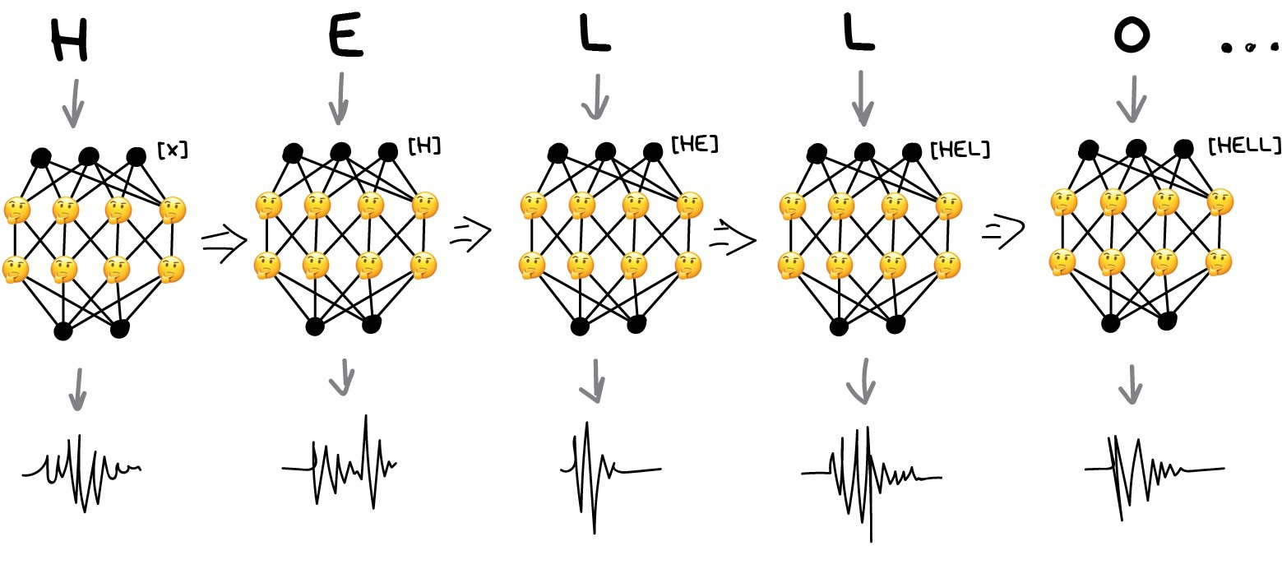
Recurrent Neural Networks (RNN)

Slide 41
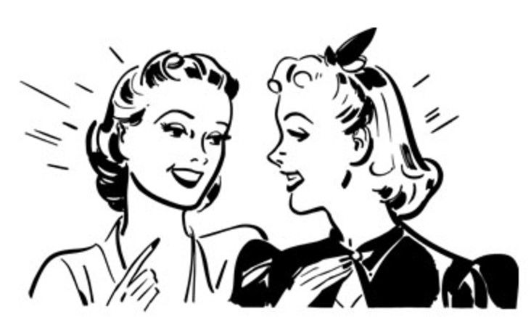
Recurrent Neural Networks (RNN)
This approach had one huge problem - when all neurons remembered their past results, the number of connections in the network became so huge that it was technically impossible to adjust all the weights.
When a neural network can't forget, it can't learn new things (people have the same flaw).
I still can’t forget my ex
How did the date go?

Slide 42
Recurrent Neural Networks (RNN)
The first decision was simple: limit the neuron memory.
Let's say, to memorize no more than 5 recent results. But it broke the whole idea.
A much better approach came later: to use special cells, similar to computer memory.
Each cell can record a number, read it or reset it.
They were called long and short-term memory (LSTM) cells.

Slide 43
Recurrent Neural Networks (RNN)
Now, when a neuron needs to set a reminder, it puts a flag in that cell.
Like "it was a consonant in a word, next time use different pronunciation rules".
When the flag is no longer needed, the cells are reset, leaving only the “long-term” connections of the classical perceptron.
In other words, the network is trained not only to learn weights but also to set these reminders.

Slide 44
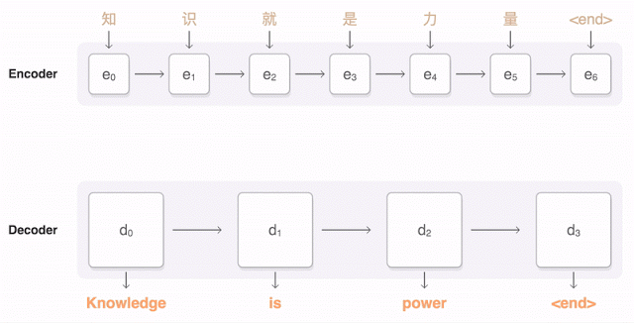
Recurrent Neural Networks (RNN)

Slide 45
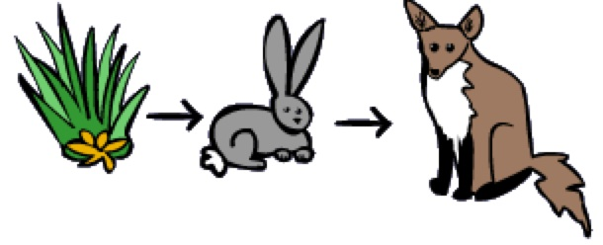
When Will There Be a War with Machines?
The main problem is, the question is wrong.
There are too many hidden conditions in it.
We say "become smarter than us" like we mean that there is a certain unified scale of intelligence.
The top of which is a human, dogs are a bit lower, and stupid rabbits are hanging around at the very bottom.
That's wrong.

Slide 46
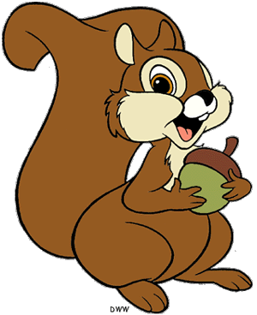
When Will There Be a War with Machines?
If this were the case, every human must beat animals in everything but it's not true.
The average squirrel can remember a thousand hidden places with nuts — We can't even remember where are our keys.
So intelligence is a set of different skills, not a single measurable value?
Or is remembering nuts stashed locations not included in intelligence?

Slide 47
When Will There Be a War with Machines?
An even more interesting question for us - why do we believe that the human brain possibilities are limited?
There are many popular graphs on the Internet, where the technological progress is drawn as an exponent and the human possibilities are constant.
But is it?

Slide 48
When Will There Be a War with Machines?
Ok, multiply 1680 by 950 right now in your mind.
You won't even try, lazy people.
But give you a calculator — you'll do it in two seconds.
Does this mean that the calculator just expanded the capabilities of your brain?
If yes, can I continue to expand them with other machines? Like, use notes in my phone to not to remember a shitload of data? Oh, seems like I'm doing it right now.
I'm expanding the capabilities of my brain with the machines.

Slide 49
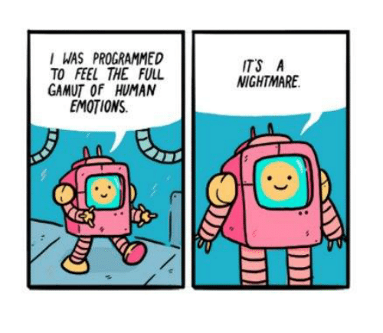
When Will There Be a War with Machines?

